Slide 1
In your Social Studies notebook, please do the following:
Put the following forms of government in order from earliest to
latest development in Greece: democracy, monarchy, oligarchy,
tyranny.
Write the word origin and definition for the following words:
democracy, monarchy, oligarchy, tyranny.
Make a chart listing a “pro” and a “con” of each of these forms of
government

Slide 2
Test Format:
Part I. Multiple Choice 90 Points
Part II. Open Response 20 Points
Total: 110 Points

Slide 3
Based on the pros and cons you identified for the four types of government (monarchy, oligarchy, tyranny, and democracy), what type of government do you think is the most effective with regards to efficiency, representation of the populace and transition of leadership?
OR
Winston Churchill once said, “Democracy is the worst form of government, except for all the others.” What do you think he meant by this? Use what you identified as pros and cons for the four types of governments as a basis for your explanation.

Slide 4
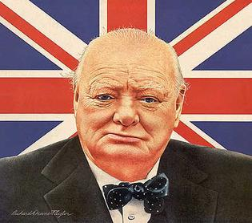
Helpful Information about Open Response Choices
Efficiency- organization, order
Populace- people living in a particular country or area
Winston Churchill- British Prime Minister in the 1940s & 1950s

