Slide 1
Citizenship in Athens & Rome: Which Was the Better system of Citizenship?
RAFT Overview

Slide 2
RAFT Planning Agenda for Today
What is it?
2. Sample RAFT
3. Brainstorm your own ideas for how to write a
RAFT to answer the DBQ question, “Citizenship in
Athens & Rome: Which was the Better System?”

Slide 3
raft
R- Role
A- Audience
F- Format
T- Topic

Slide 4
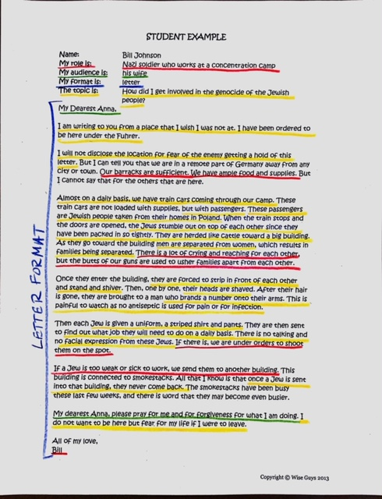

Slide 5
Role Audience Format Topic
Athenian citizen Future historians Letter or speech Athens had the better system of citizenship
Athenian woman Roman Senate Treaty Rome had the better system of citizenship.
Athenian slave Athenian Assembly 2-way conversation
Free-born Roman woman Conquered Gauls Petition
Old Oligarch of Athens News reporter Diary/blog
Themistocles Future diary reader Social media page
Roman Senator Advice Column
Claudius Ancient rap, song, poem
News reporter
Tribune
Patrician
Plebeian
Roman child
Conquered Gauls

Slide 6
RAFT Prompt Ideas:
Regardless of which prompt you choose, you must use at least 3 documents to support your arguments.
I am a Roman female born to Roman citizens. I am writing a letter to an Athenian woman to persuade her to move to Rome for its beneficial treatment of women.
I am a male citizen in Athens. I am off on a trading expedition and arrive in the Roman Republic. I start a conversation with a Roman about the benefits of citizenship in Athens. Describe how an Athenian male might argue that being a male citizen in Athens was better than being a male citizen in Rome.
I am a Roman Senator who has recently been in contact with an Athenian Councilman. I am writing to the emperor to convince him that the Athenian method of ostracism may be better for the Republic than the use of Censors.

Slide 7
 | 1 | 2 | 3 | 4
Structure | Incomplete or missing many components of RAFT format | Working towards but missing components | Writing reflects all components of RAFT format. | Exceeds expectations
Content | Less than 2 pieces of documents evidence. Less than 2 pieces of content vocabulary used correctly | Less than 3 pieces of Document evidence. Less than 3 content vocabulary words used correctly. | Minimum 3 pieces of document evidence appropriately matched to role, audience and topic. At least 3 number of content vocabulary words, used correctly. | Exceeds expectations
Product | Missing works cited document, missing Raft proposal | Incomplete works cited document. RAFT proposal not submitted for prior approval. | Attached works cited document. Attached RAFT proposal(submitted for prior approval) | Exceeds expectations
Conventions | Conventions well below grade level | Approaching grade level control of spelling, including content vocabulary words, capitalization, punctuation, grammar, and usage. | Writing demonstrates grade level control of spelling, including content vocabulary words, capitalization, punctuation, grammar and usage. | Exceeds expectations
Overall Quality | Quality is well below grade level | Final product is approaching grade level organization, creativity, effectiveness in conveying ideas. | Final product is neat, well organized, creative, and effective in conveying ideas. | Exceeds expectations

