Slide 1
Hammurabi’s Code: Was it Just?
Grade 7 Social Studies DBQ
November 2019

Slide 2
DBQ Process
Background Essay & Document Analysis (Monday 11/4-Thursday 11/7)
Debate Preparation (Friday 11/8-Tuesday 11/12)
Debate (Wednesday, 11/13)
Writing Process Overview (Thursday, 11/14)
DBQ Writing (Friday, 11/15, Monday 11/18, & Tuesday 11/19)

Slide 3
DBQ Notebook Set-up
Organization is key!!
On next clean page in your Social Studies notebook, write the heading “Hammurabi’s Code Background Essay” and Monday’s date, 11/4/19
Next write sub-heading, “Background Essay Summary”

Slide 4
Document Organization
On the next 5 blank pages in your Social Studies notebooks, glue a yellow organizer onto to the top of each page.

Slide 5
Justice: The quality of being just (fair) and reasonable. The administration of the law or authority in maintaining fairness.

Slide 6
Background Essay Activity
After each paragraph is read aloud, we will pause
so that you can write 3-4 words in the margin about
the paragraph.
After we read the entire essay, look back in the
margins and write a 2-3 sentence summary of the
entire background essay in your Social Studies notebook. Please write the summary on a clean notebook page with today’s date (11/04/19) labeled clearly at the top.

Slide 7
Background Information (for introduction to essay)
Write at least two sentences about Hammurabi (from Background Essay)
Talk about the empire of Babylonia (part of Mesopotamia)

Slide 8
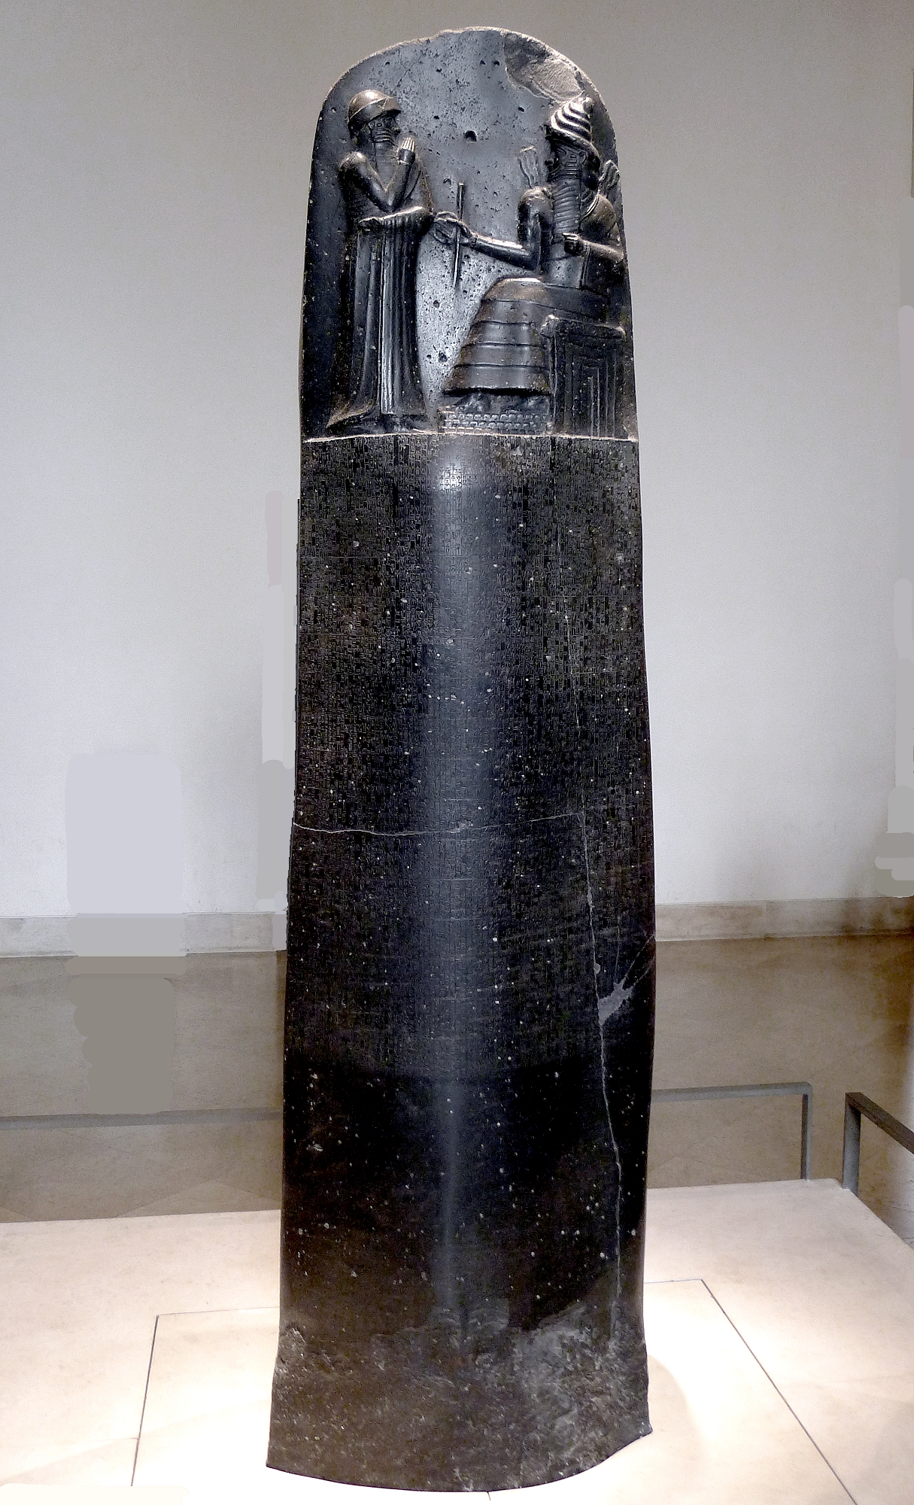
Document A
-Stele on display today at the
Louvre Museum, Paris
-found by Swiss anthropologist
in Iran in 1901
-believed to have been created in
38th year of Hammurabi’s reign
(so about 1754 BCE)

Slide 9
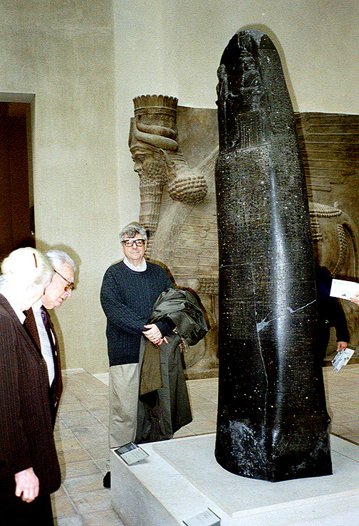

Slide 11
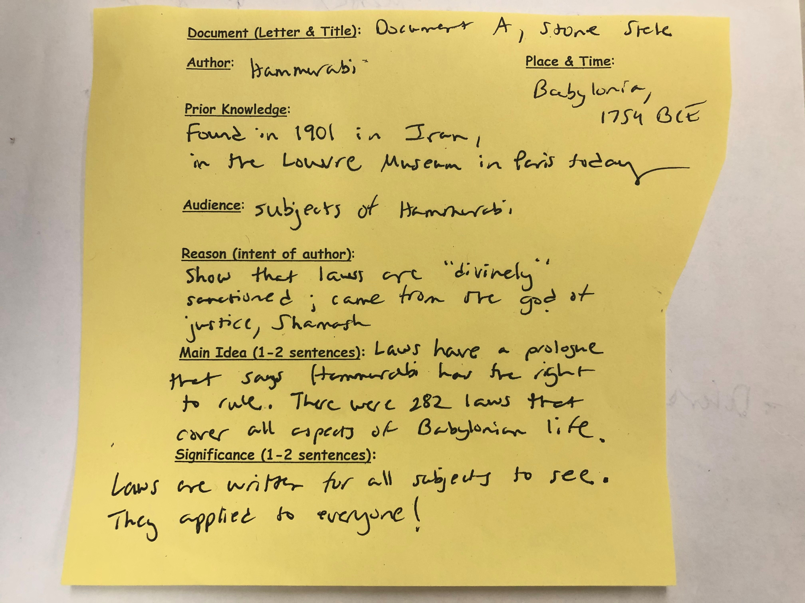

Slide 12
Document B: Epilogue (conclusion) of the Code
-Hammurabi emphasizes just how fair he is in the epilogue
-Hammurabi’s goal---legal protection for the weak
-Hammurabi wanted the laws to last forever…
*stele weighs 4 tons
*wished for bad things to happen to future rulers who did not obey the Code
-

Slide 14
Document (Letter & Title): Document B, Epilogue
Author: Hammurabi Place & Time: Babylonia, 1754 BCE
Prior Knowledge: Hammurabi wanted the laws to last forever. The stele weighed 4 tons.
Audience: Hammurabi’s subjects
Reason (intent of author): To protect the weak, and prevent the strong from injuring the weak
Main Idea (1-2 sentences): Hammurabi, through his law code, is trying to protect the “weaker” members of society. He curses future kings and their families, soldiers, and subjects, if they do not continue to follow his laws.
Significance (1-2 sentences): Hammurabi claimed that his laws were from the god Shamash, and, therefore, had to be followed by Babylonian subjects. He had very harsh words for future generations who dared to change his Code of Laws.

Slide 15
Document C: Family Law
-Family law can include issues of marriage (and divorce),
adultery, parent-child related issues, and adoption
-30 laws call for the death penalty, but many others specify mutilation of a body part (either body part of victim that was injured, or body part that was used in the offense)
(This could be good “prior knowledge” information for your notes!)

Slide 16
Document (Letter & Title): Document C, Family Law
Author: Hammurabi Place & Time: Babylonia, 1754 BCE
Prior Knowledge: 30 laws call for the death penalty, but many others specify mutilation of a body part (either body part of victim that was injured, or body part that was used in the offense)
Audience: Hammurabi’s subjects
Reason (intent of author): To protect the weak, and prevent the strong from injuring the weak
Main Idea (1-2 sentences): Laws about family life protect “weaker” members of society, such as women who get sick and children. It also punishes those who disrupt family life through disrespect of parents and adultery.
Significance (1-2 sentences): Hammurabi, through his law code, is trying to protect the “weaker” members of society. He is also trying to prevent families from falling apart because of immoral behavior.

Slide 17
Document D: Property Law
-Property law involves issues theft, general ownership of property, maintenance of irrigation systems
-Most people who lived in the Babylonian Empire were farmers.
-Law 23 is similar to Hebrew and Arabian law, which made the
local community responsible for unsolved crime in the area. This
shared responsibility gave everyone a stake in reducing crime.
(This could be good “prior knowledge” information for your notes!)

Slide 18
Document (Letter & Title): Document D, Property Law
Author: Hammurabi Place & Time: Babylonia, 1754 BCE
Prior Knowledge: Law 23 is similar to Hebrew and Arabian law, which made the
local community responsible for unsolved crime in the area. This
shared responsibility gave everyone a stake in reducing crime.
Audience: Hammurabi’s subjects
Reason (intent of author): To protect the property of the subjects of Babylonia
Main Idea (1-2 sentences): Laws about property protect Hammurabi’s subjects from financial ruin. They also make it so that a person’s negligence is punishable.
Significance (1-2 sentences): Hammurabi, through his law code, is trying to protect the property of people in his kingdom. The laws come before any type of formal insurance.

Slide 19
Document E: Personal Injury Law
-Personal Injury law deals with both intentional and unintentional injury
-Social class impacted the types of punishments that a person would receive (This could be good “prior knowledge” information for your notes!)
-Can laws that have different consequences based on
one’s social class really be considered “just”?

Slide 20
Document (Letter & Title): Document E, Personal Injury Law
Author: Hammurabi Place & Time: Babylonia, 1754 BCE
Prior Knowledge: Social class impacted the types of punishments that a person would receive
Audience: Hammurabi’s subjects
Reason (intent of author): To protect people from personal injury, both intentional and unintentional
Main Idea (1-2 sentences): If someone suffers an injury, the code of laws provides a punishment as close to equal as that injury. The penalties, however, vary depending on the social class of the victim.
Significance (1-2 sentences): Hammurabi, through his law code, is trying to protect people in his kingdom from physical harm.

Slide 21
Just (Fair) Unjust (Unfair)

Slide 22
Just (Fair) Unjust (Unfair)
Property laws
Ancient form of insurance
Family Laws
Women were protected
Personal Injury Law
Equivalent Retaliation
Farmers were protected
Laws came from Shamash
Social classes treated differently
Women treated unfairly
Property laws unfair
Unintentional injuries punished the same as intentional
Penalties too harsh
Slaves treated as property, not humans

Slide 23
Reason #1:
___________________________________________________________________________________
___________________________________________________________________________________
Evidence that goes with reason #1: (cite 2 specific laws here)
___________________________________________________________________________________
___________________________________________________________________________________
___________________________________________________________________________________
Connect to claim (why is this law fair/unfair)?
___________________________________________________________________________________
___________________________________________________________________________________
___________________________________________________________________________________

Slide 24
DBQ Process
Background Essay & Document Analysis (Monday 11/4-Thursday 11/7)
Debate Preparation (Friday 11/8-Tuesday 11/12)
Debate (Wednesday, 11/13)
Writing Process Overview (Thursday, 11/14)
DBQ Writing (Friday, 11/15, Monday 11/18, & Tuesday 11/19)

Slide 25
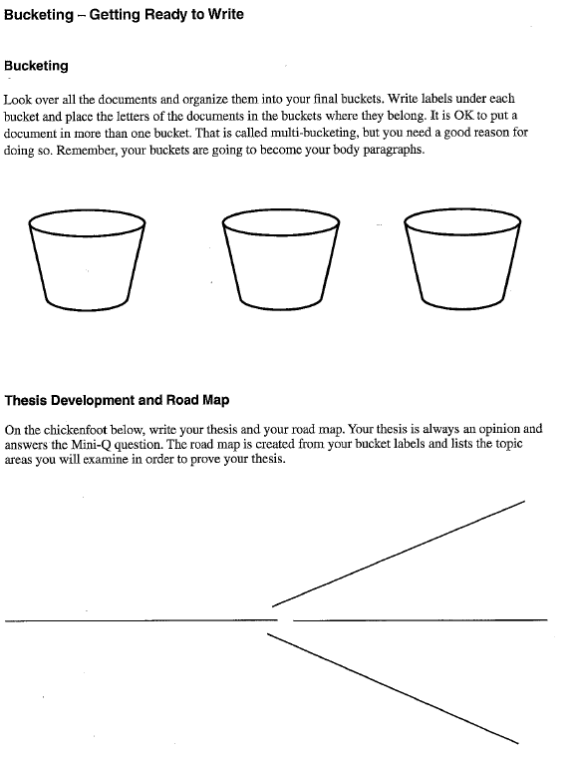

Slide 26
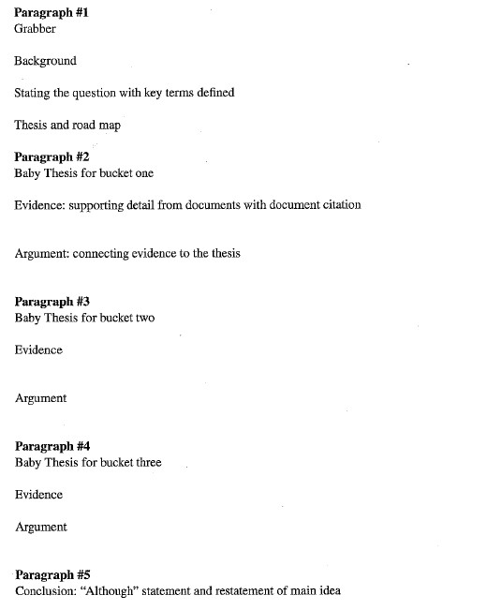
TITLE: Was Hammurabi’s Code Just?
Introduction
BABY THESES: Reasons why Hammurabi’s Code was just (fair) or unjust (unfair)
Body Paragraphs
ARGUMENT: Explain how this reason shows that Code was just or unjust.
Conclusion

Slide 27
Types of grabbers/hooks
Story/description hook: Short story/episode that describes a scene in Babylonia where law code is being put to use.
Fact/statistic hook: Example: Almost two-thirds of American adults at some point in their life lived in a home with at least one gun.
Quotation hook: Could be a quote from a famous person about justice. Must go with your claim/thesis. “An eye for an eye leaves the whole world blind” Mahatma Gandhi

Slide 28
Story/Description Hook
In a fit of frustration, a Babylonian teenage boy verbally and physically lashes out at his father. His punch lands squarely on his father's chin, knocking him to the ground. They look at each other, stunned both by what just occurred and by the potential consequences of the boy's actions.

Slide 29
TITLE: Was Hammurabi’s Code Just?
Introduction
BABY THESES: Reasons why Hammurabi’s Code was just (fair) or unjust (unfair)
Body Paragraphs
ARGUMENT: Explain how this reason shows that Code was just or unjust.
Conclusion

Slide 30
Body Paragraph (2-4) Tips
Baby Thesis Each paragraph should start with a topic sentence (that is your main idea for that paragraph).
Evidence Each paragraph should give evidence to support of the thesis (and evidence should be cited using parentheses).
Argument The idea is to use the evidence to construct an argument so the reader will agree with your thesis.

Slide 31
Some examples for citing evidence
If a man blinds another man of equal social standing, his eye will be knocked out (Doc E).
If a farmer is negligent in taking care of a canal or dam on his property, then he will be
sold into slavery if he cannot repay a neighbor whose crops have been lost because of
his laziness (Doc D).
If a boy is kidnapped, his kidnapper will be put to death (Hammurabi’s Code of Laws 14).

Slide 32
Concluding paragraph
Conclusion: “Although” statement and restatement of main idea and reasons
“Although some might argue that… (insert counterclaim and reasons here), and rebuttal (reasons why that’s not true)”.
Restatement of you main reasons why the code is either just or unjust.

Slide 33
