Slide 1
Egyptian Social Class Skits Backgrounds

Slide 2
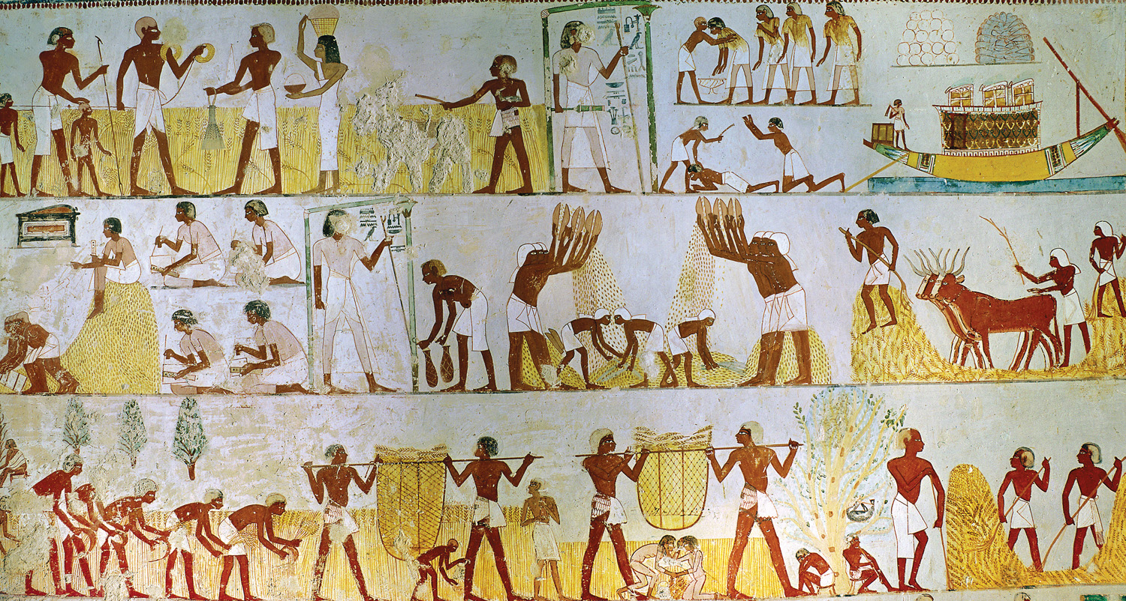

Slide 3
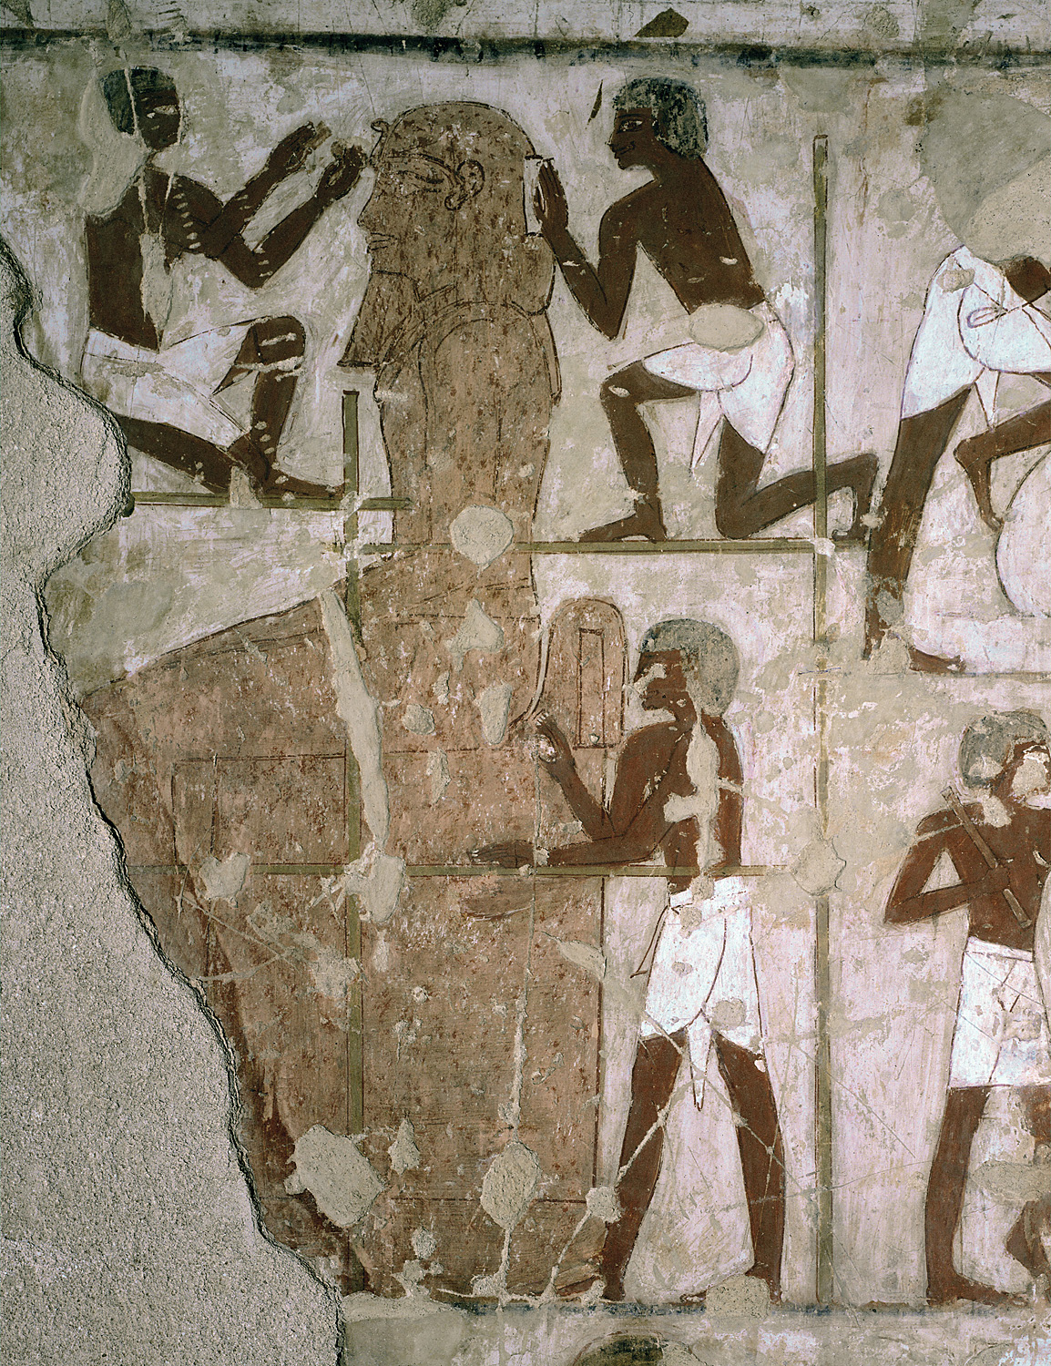

Slide 4
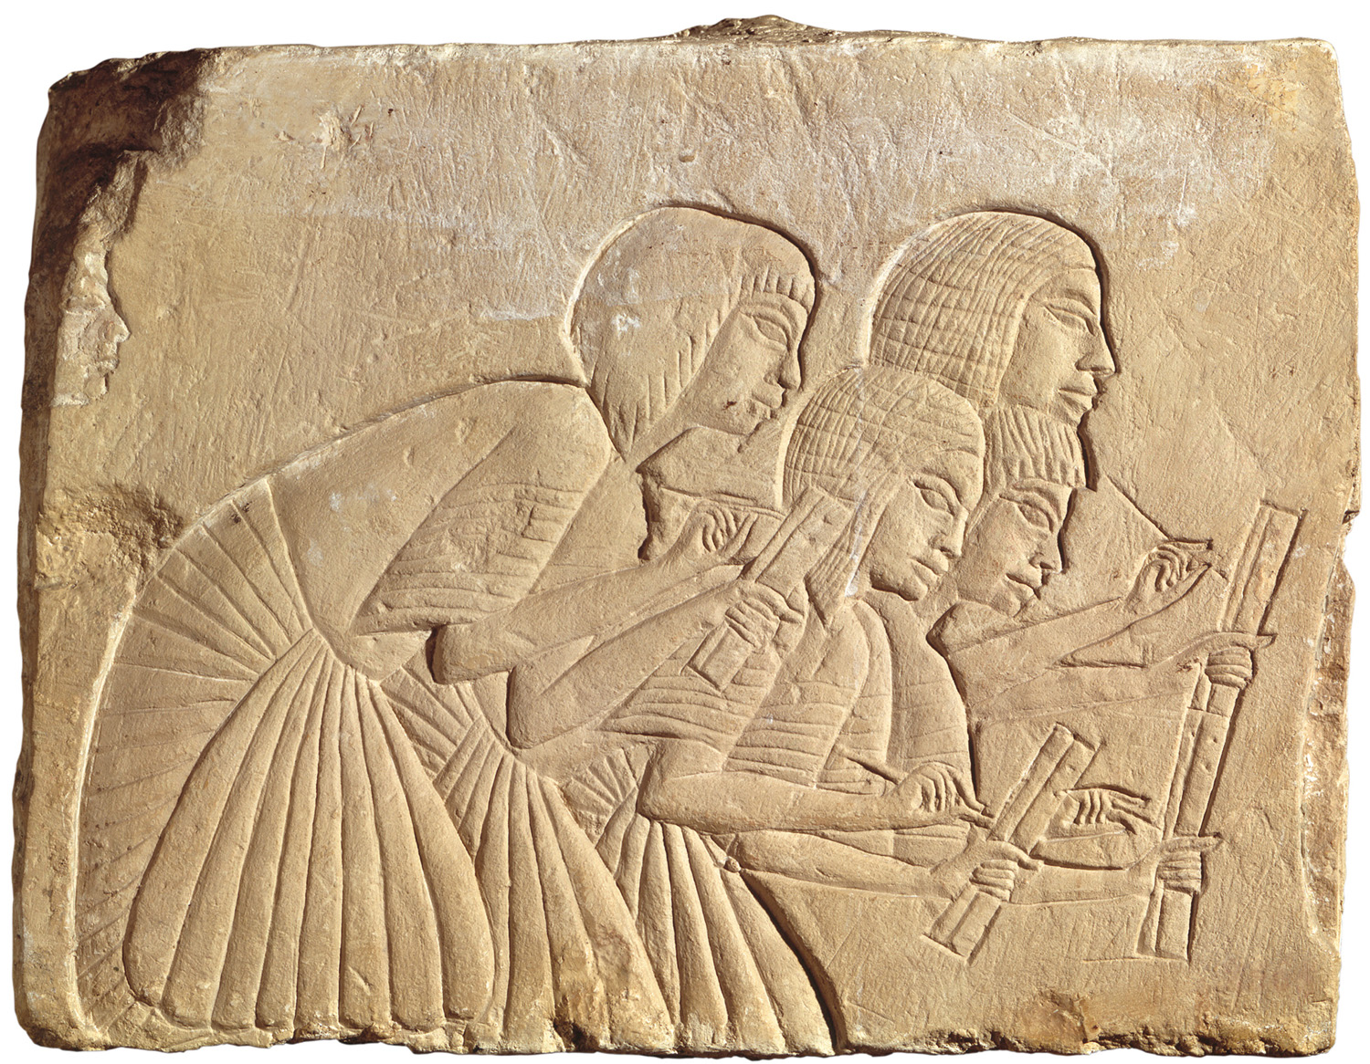

Slide 5
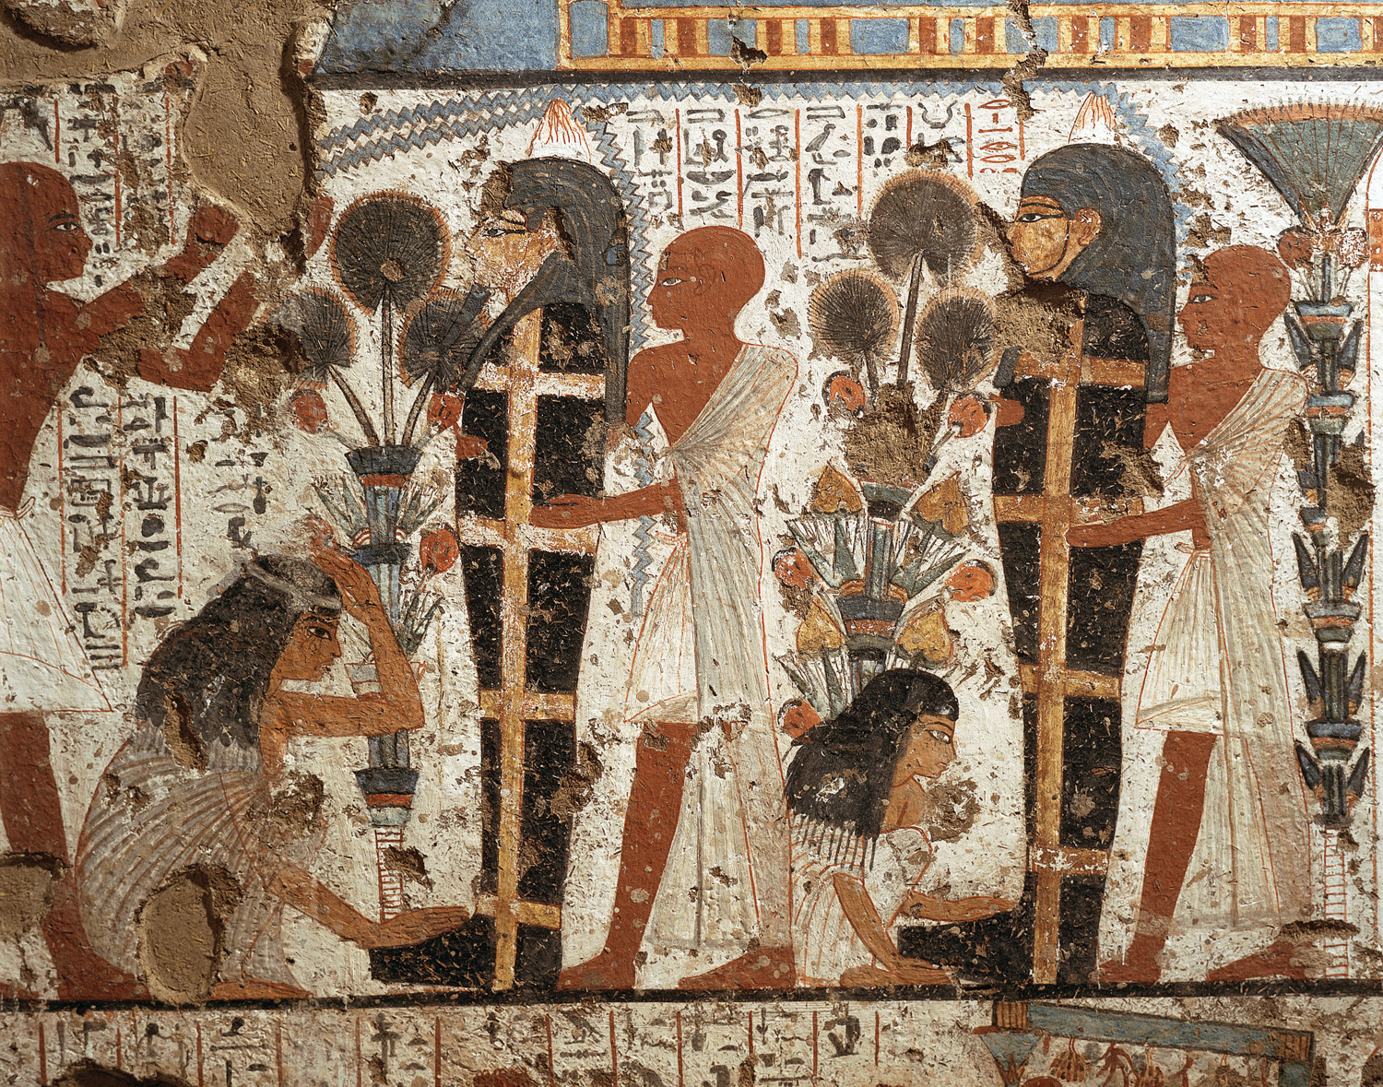

Slide 6
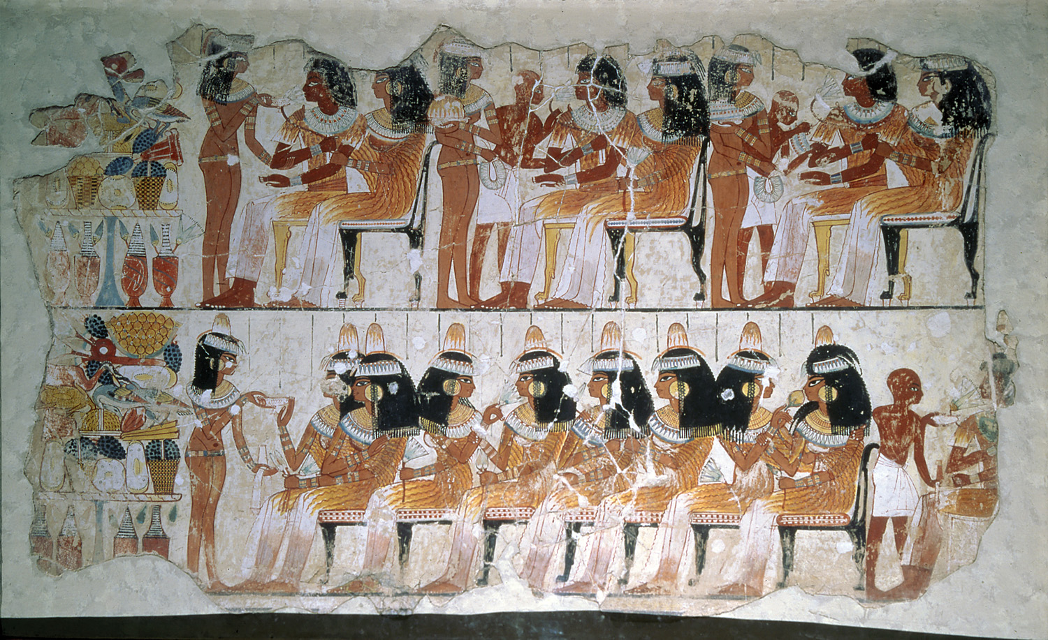

Slide 7
Test Format
Part I. Egyptian Social Class Pyramid (12 points)
Part II. Multiple Choice (40 points)
Part III. Pharaohs (30 points)
Part IV. Characteristics of Civilization (20 points)
Total: 102 Points

Slide 8
In your Social Studies notebook, please respond to the following question:
How did religion influence ancient Egyptian society?

