Slide 1
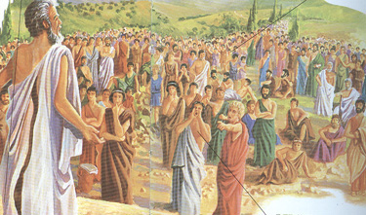
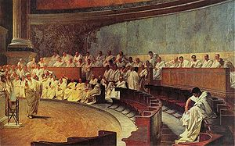
Citizenship in Athens and Rome: Which was the Better System?

Slide 2
Social Contract Theory of Citizenship
Athenians were not as concerned with “rights” as they were “responsibilities”
Utmost of importance to maintain the “polis”

Slide 3
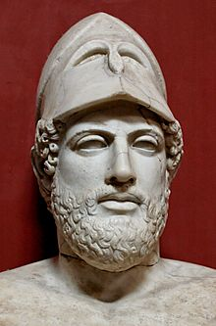
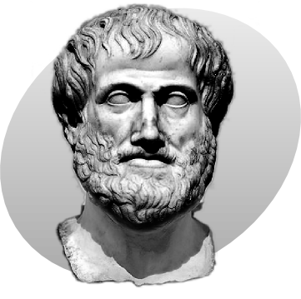
Pericles (495 BCE-429 BCE)
Aristotle (384 BCE-322 BCE)

Slide 4
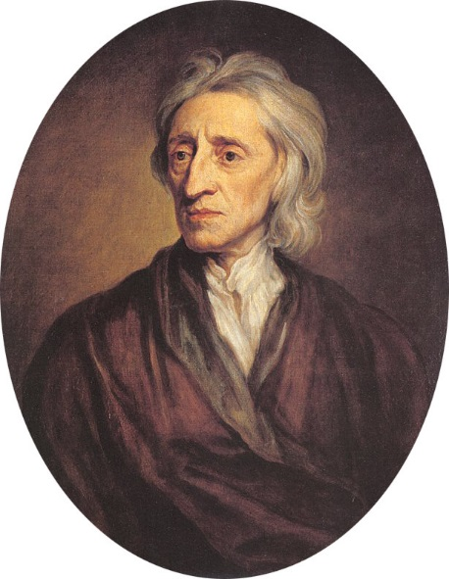
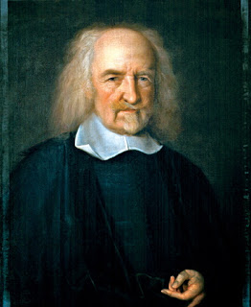
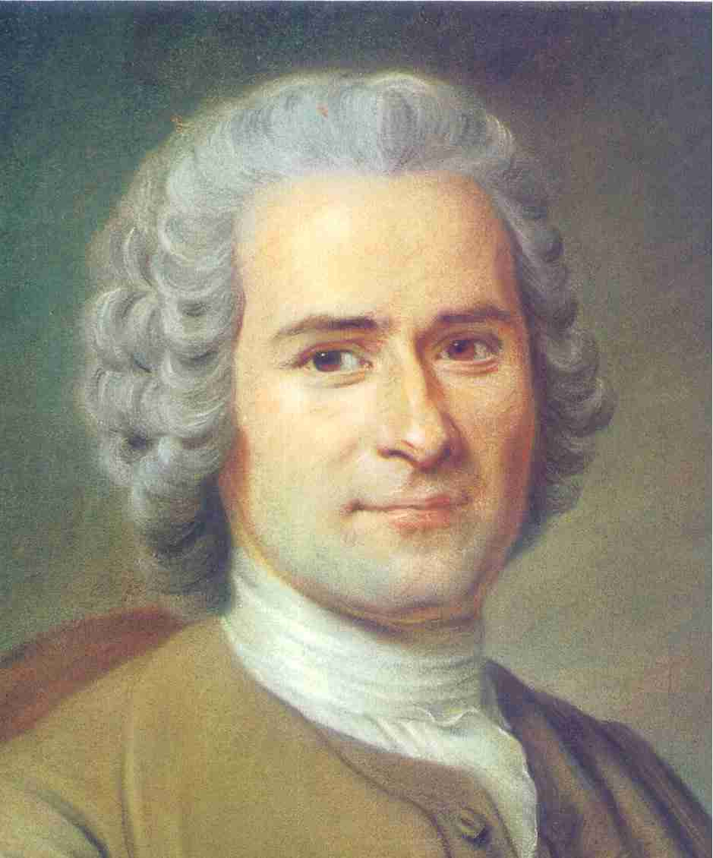
John Locke (1632-1704)
Thomas Hobbes (1588-1679)
Jean-Jacques Rousseau (1712-1778)

Slide 5
Citizen- A person who owes loyalty
to a country and receives certain
rights in return

Slide 6
Social Contract Theory of Citizenship- balance between individual rights & responsibilities

Slide 7
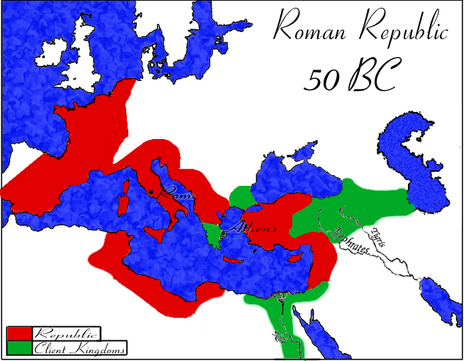

Slide 8
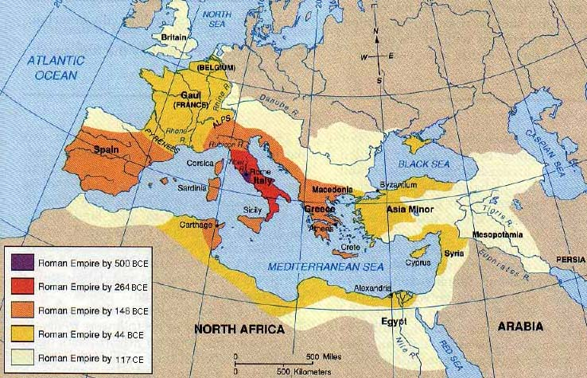

Slide 9
Background Essay Activity
After each paragraph is read aloud, we will pause
so that you can write 3-4 words in the margin about
the paragraph.
After we read the entire essay, look back in the
margins and write a 2-3 sentence summary of the
entire background essay in your spiral notebook.

Slide 10
Citizen- A person who owes loyalty
to a country and receives certain
rights in return
Subject- a person who lives in a country but is not given any rights by the government
Social Contract Theory of Citizenship- balance between individual rights & responsibilities

Slide 11
City-state- an independent territory with its own government and food supply
philosopher- a person who studies the meaning of life
Roman Republic- 509 BCE-27 BCE- Roman democratic government in place for over 4 centuries

Slide 12
Understanding the Question &
Pre-Bucketing
What is the analytical question asked by this Mini-Q?
What terms in the question need to be defined?
Rewrite the question in your own words.

Slide 14
Document A- Athens & Rome: Who Could Be a Citizen?
In 432 BCE, while compiling a military census, the Greek
historian Thucydides made the following population
estimates for Attica, which including Athens and its
surrounding farmlands:
Free male citizens: 50,000
Free male non-citizens 50,000
(foreign born or with foreign parents)
Free females (all ages) 100,000
Slaves: 115,000
Total: 315,000

Slide 15
Under Pericles, Citizenship requirements got stricter:
Introduced parentage requirements
Those with foreign mothers were now excluded
People lost citizenship
No one was grandfathered in (not given citizenship even if already in Athens)
According to Aristotle, this tightening of requirements had to do with population increase and keeping the number of citizens, and therefore participants in government, manageable.

Slide 16
Document B Vocabulary Preview
steersmen-who steer the boat
boatswains- senior crewman responsible for hull of ship
shipwrights- ship builders

Slide 17
Document C- Claudius Speech
Romans had different levels of citizenship:
Cives romani (Roman born male citizens)
non optimo jure
optimo jure
Latini- people from regions outside Rome but on the Italian peninsula-
right to do business and to travel within Empire, but not to an official
Roman marriage
Foederati- citizens of states with treaty obligations with Rome- were given
limited rights in return for performing military service
Peregrini- foreigners in conquered lands- could be given full or partial
citizenship

Slide 18
Document D: Ostracism in Athens
-used to diffuse trouble, or get rid of someone
who was growing too powerful
-could only be done once a year
-citizens wrote names on a shard of pottery (ostraka)
-Themistocles

Slide 19
Ways in Which Citizens Could be Disqualified in Athens
Document E: The Athenian Assembly
Not legally married
Neglecting his parents
Offending public morals
Avoiding military service
Owed money to the city-state

Slide 20
Document F: Roman Senate
Appointment to the Senate was usually for life.
However, a Senator could be dismissed for criminal
or immoral behavior.
Speaking privileges were given to those in order
of social rank
The speaking rights of senators meant that a vote
could be delayed by continuing debate through lengthy
speeches (modern idea of a filibuster comes from this)

Slide 21
Types of Hooks
-anecdote
-quote
-strong statement of fact
-rhetorical question

Slide 22
Sample Anecdote
In a fit of frustration, a Babylonian teenage boy verbally and physically lashes out at his father. His punch lands squarely on his father's chin, knocking him to the ground. They look at each other, stunned both by what just occurred and by the potential consequences of the boy's actions.

