Slide 1
Citizenship in Athens and Rome March 20, 2019
Which was the Better System?

Slide 2
Agenda
Rules
Opening Statement
(if a person wishes to make one on behalf of team)
Participants Debate
Closing Remarks (if any)

Slide 3
Rules
Be polite and courteous.
Listen attentively.
Be respectful and supportive of peers.
Avoid inappropriate noises.
Speak only when recognized by the moderator (Mr. Mash).
Allow others to express their opinions; do not monopolize the debate.
Use grammatically correct language.
Speak clearly, slowly, and loud enough to be heard by the audience.

Slide 4
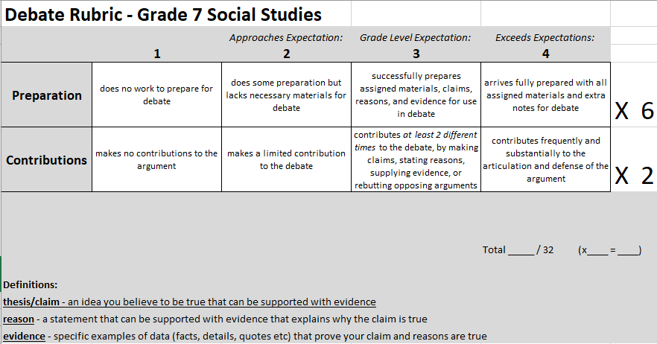

Slide 5
Possible Debate Vocabulary
Citizen
Subject
Assembly
Council of 500
Ostracism
Democracy
Tyranny
Oligarchy
Republic
Filibuster
Veto
Cives Romani
Latini
Peregrini
Foederati
Census
Censors
Patricians
Plebeians
Tribune
Senate

